Slide 1







Interfaces, Models, and Monitoring for Resource-aware Transformations that Augment the Lifecycle of Systems (IMMoRTALS)
Matt Gillen (BBN)

Slide 2
Outline
Program Status/Summary (Matt)
Where we are/Accomplishments
IMMoRTALS Basics (Matt)
Challenge Problems, Motivating examples, concept of operation, illustration of the problem/solution space and complexity
Technical Deep Dive (Matt introduces and then hands off)
Summarize current thrusts that we are working on, identify the 1 or 2 that we will deep dive into
Candidates for deep dive (will we have time for all?)
Modeling the ecosystem– why it is important, what have we done, what next (Vanderbilt)
Discovering resource dependency and requirements– why it is important, what have we done, what next (two parts– Syracuse and OSU/Alex)
DAS in action– demo/screenshots (BBN)
Plans for the next quarter (Matt)
Conclusion (Matt)

Slide 3
Program Status
Platform Instantiation
Challenge Problem Definition
Reasonably complete
Vocabulary/Ontology
Environment Model
Ongoing work, initial capabilities developed
Program Analysis
Resource DSL
DAS
CP in DAS
Adaptation/CP Enhancements
Recently Started
We are here
Publications (list them?):
1 presented already
2 accepted
3 in submission
Notes:
Note for the speaker: Stood up the platform, published the two CPs, have a vocabulary to represent the functional and extrafunctional aspects of the program and the ecosystem, have initial capabilities for program analysis to discover resource dependency and usage, DSL for checking, working DAS v1– not pretty looking or with nice interfaces– in process of integrated the upgrades of the components, CP1 working in the DAS v1, CP2 is in process, and also already started looking an enhancements to CPs that will stretch the limits of current analysis and synthesis capabilities. And started publishing..
List of publications

Slide 4
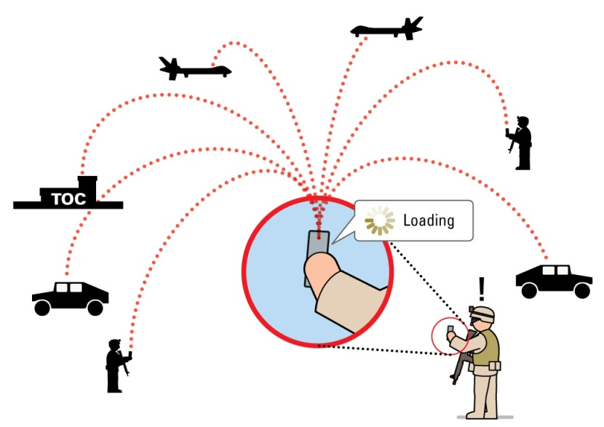
IMMoRTALS Basics (1)
IMMoRTALS Domain/Context: Situation Awareness (SA)
Important and relevant: Situation Awareness (SA) is a key part of modern warfare, law enforcement, humanitarian missions, etc.
Manageable scope: The domain defines the kind of information being processed (i.e., what are SA data) as well as the kind of processing (i.e., sharing, analysis, requesting)
Rich source of diverse and changing use cases and requirements
Notes:
Note to speaker: the domain we picked is important. The domain restricts the kind of functions/functional specification/patterns of usage to a manageable size as compared to general purpose programs– helps us develop techniques to understand and adapt these programs. The domain is also rich enough to offer lots of changes that are needed and meaningful.

Slide 5
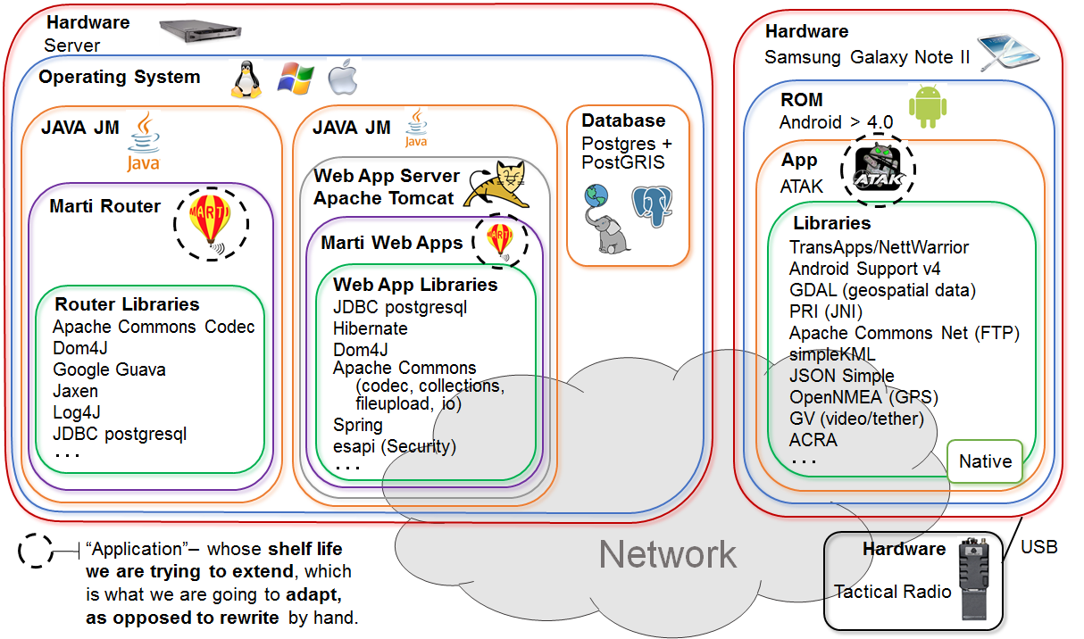
IMMoRTALS Basics (2)
IMMoRTALS Platform: Tactical SA Information Sharing
Right information at the Right time to the Right people - even more important in the tactical situation
Familiarity with the operational use, evolution of requirements
IMMoRTALS Application: there are two
Android client and Java server
Many and changing operating environments→ more opportunity to adapt and evolve
Notes:
Note to speaker: our platform is tactical and info sharing– why is this important and why we chose this, and that ours is probably the unique that the application has two components– client and server, which implies even richer dependencies (e.g, encrypt on one side → decrypt on the other)

Slide 6
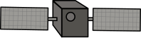



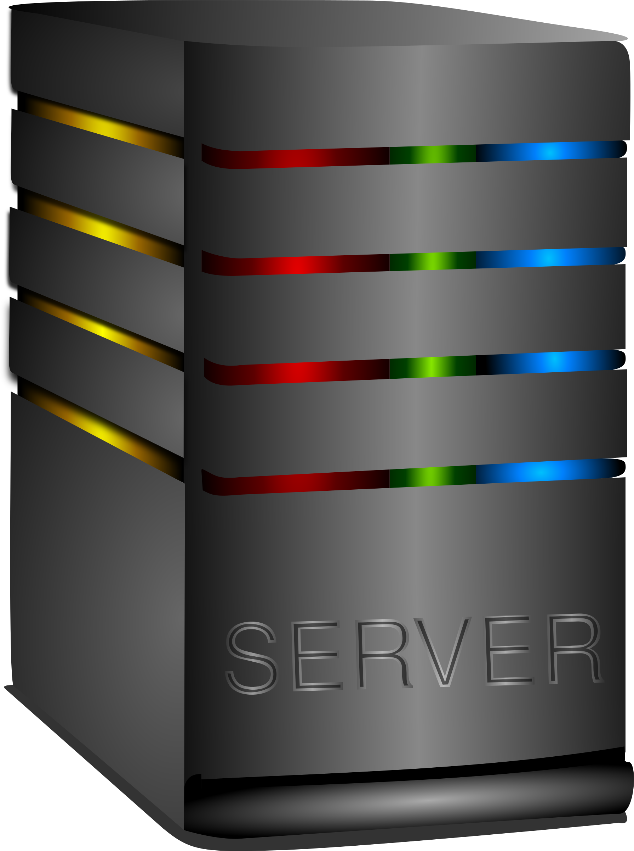



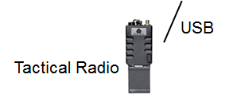



IMMoRTALS Basics (3)
IMMoRTALS Ecosystem: HW and Software resources that the two applications depend on
Traditional shared systems resources (CPU, Memory, Bandwidth), and resources like libraries, hardware devices, external services
And also, the mission where the SA application is engaged (i.e., the mission requirement influence what is important to the application)
Environment
Mission Req
X …
X …
X ...
GPS
Ecosystem
influences
Notes:
Note to speaker: not just the hw and sw environment but also the mission where the app is used is in the ecosystem– they both influence how the apps should be configured, adapted, and how they behave

Slide 7
IMMoRTALS Basics (4)
IMMoRTALS Assumptions
Applications are built as a software product line (well-defined architecture and components)
Functional specification is provided
Extra functional dependency and specification is inferred
Not every line of the application is evolvable, only the point of use of PLA components are
In response to ecosystem changes, IMMoRTALS aims to (make applications):
Adapt: accommodate/respond to change by various means, may not always result in new program versions (e.g., runtime adaptation)
Evolve: results in new versions/variants of application programs

Slide 8
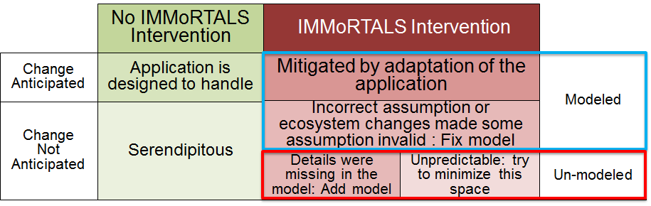
How Does IMMoRTALS Do IT ?
IT: Adapt software to accommodate ecosystem changes
Changes in the operating environment: libraries, hardware, systems resources etc.
Changes in mission requirements
Immortals uses models to represent and reason about functional and extra-functional aspects of software and its ecosystem
Models and changes have an interesting interplay
In addition to adapting the application
IMMoRTALS aims to achieve its goals by
Constructing and analyzing models of applications (functionality and resource dependency and usage) and the ecosystem
Using substitution, elimination and addition of functionality (facilitated by code and behavior modification)
Notes:
Notes for speaker: so how does immortals do it. Lets reiterate what the IT refers to– adapt sw to accommodate ecosystem (both systems env and mission) changes. Immortals relies on models a lot (explain the bottom bullet). There are all kinds of changes, and modeling and changes have an interesting interplay– the figure– explain what we are trying to do

Slide 9
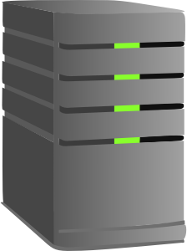

Where Are We: Baseline Application
Designed for < 20 users to share locations
GPS-based, using Android’s internal GPS device+API
No auditing, security requirements
Changes we plan to handle
Systems resource: memory, CPU, bandwidth, available sensors on Android
Software: 3rd part library. OS and remote services
Mission Requirement: No of clients, report rate, image quality, data at rest/transit security, Trust/Accuracy of location, Auditing
Initially we are focusing changes in mission requirements, modeled as qualifiers on functional aspects of the program components.
Notes:
Explain the base line, changes covered etc.

Slide 10
Overview of Phase 1 CPs
CP1: Resource consumption by clients are independent of each other
CP2: Add aggregate resource consumption and dependence
Android Hardware changes
Built in GPS?
Bluetooth?
USB?
Environment changes
GPS satellite visibility
Mission requirements
Hands off?
Trusted GPS needed?
All the variations from CP1
Environment changes
Available bandwidth
Mission requirements
Number of users
Report Rate
Image fidelity
Potential enhancements (mission requirement change)
Auditing (e.g. legal req. to record track history)
Data-at-rest security
Data-in-transit security
Wire-format (e.g. integration with legacy systems, use less efficient wire format)
3rd party library changes
Notes:
Summarize Phase 1 CP, initially all pre-deploymenty. Could cover runtime situations—first triggering offline adaptation(evolution) and deployment of new code, later more online adaptation…

Slide 11
CP2 Illustration
Has animation….
New mission (e.g., a major event): large number of clients
(and/or the environment has a thinner pipe)
We are deploying for this new mission, give me an application that works
OR
Baseline deployment: less than 20 clients
Oops! Deployed the baseline to this new mission and it does not work!
The baseline application needs to adapt:
Mission requirement: clients still need to share SA data (“intent preservation”)
Congested resource (bandwidth) is getting in the way
Challenges in responding to this kind of changes
Identify constrained / oversubscribed resources
Identify parts of the application that are affected
Find adaptations that might be added to relieve the constrained resources
Notes:
Here, we digress a bit from what we are– to present the inner works and complexities that we are dealing with. The change request can come before we deploy for the new mission, or we may realize that the baseline application does not work after we deployed then in large number in the new mission, which triggered an emergency change request to the developers

Slide 12
(Animate/Organze) Partha To Do
Functional aspects: which function is sending location data, and where is this function called in the application
PLA/Product Configuration: e.g., each clients sends location data once per second
Resource check in new env:
NW BW is the congested resource
100s of clients, 1 send per sec, x bytes per send, av bandwidth– type system
Look for mitigation
Can we send less frequ: check with mission req
Is there a way to send less per send
New send location data function (works now)
Look for ways to reduce what is being send (working on it)
Compress– code/raw material exists
Create a new version of the application whose sendLocation data compresses before sending
Obligation– need to inform receiver to uncompress– for this case it is still the client
Program Analysis: socket writes→ up the call graph → the functions that send location data
Estimate of data sent to network per call (based on test data for dynamic analysis)

Slide 13
Other variations
SA applications with a fixed report rate might vary in both report rate and number of clients, both of which have implications for bandwidth usage.
Image size affects both bandwidth consumption and CPU consumption.
Scenarios might change rate, number of clients, image size, available bandwidth

Slide 14
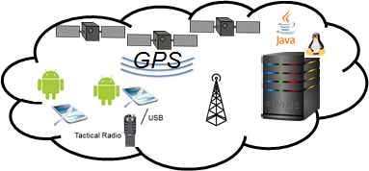

Current State
Dynamic inputs (ecosystem model)
Configure the environment (test bed)
Environment
Mission Req
X …
X …
X ...
Static inputs
Resource DSL
Discovery
Analysis
Feature Model
SemWeb queries
App Model
Adapted application
f₁ * f₂
(g+h)
x
Permanent Store
DFU Types
Edit, build and test
Partial Annotations
r₁ {...}
r₂ {...}
@dfu
...
@dfu
r₁ {...}
r₂ {...}
@dfu
...
@dfu
r₁ {...}
r₂ {...}
@dfu
...
@dfu
The environment & mission influence the shape and configuration of the constructed system
Notes:
Here we get back to where we are….
Shapes are artifacts, gears are processes
Think of the gears are different parts of the DAS working, which parts take what input and produces what. Lots of moving parts and features, we will not summarize most, but do a deeper dive into the encircled parts. Wi

Slide 15
Plan for the next few slides
Is this the right flow?
Start with
Code, environment
Need to be able to reason about applications resource usage, resources provided by the environment and mission requirements
Functional spec, PLA-- given
Application– inferred by program analysis
Ecosystem- using modeling tools
Representing the model (Triple store)
Reasoning about the application, new resource situation, mission requirement
TA4 interface and prescribed diagram?
Notes:
Outline for the next sections

Slide 16
Discrete Functional Units
DFUs are an IMMoRTALS concept that links together functional requirements (Features), code (Implementation) and extra functional specification (Resource dependency and usage)
IMMoRTALS representation of DFUs include
Functional Specifications
Resource consumption
Dependencies
DFU metadata can be discovered automatically (Muse / Droidscope / Mutation Testing), or through explicit programmer annotations
Notes:
Before we deep dive– a few more basics

Slide 17
PlaceHolder: Outline for Syr/UCR
Expect update from Yue

Slide 19

Modeling the Ecosystem
What is the ecosystem?
Why is the ecosystem important?
What have we done to model the ecosystem?
What next?
Adaptation demands originate from the ecosystem
Notes:
Modelling the ecosystem
What is the ecosystem?
Why is the ecosystem important?
What have we done to model the ecosystem?
What next?

Slide 20
Modeling the Ecosystem
What is the ecosystem?
Why is the ecosystem important?
What have we done to model the ecosystem?
What next?
Dynamic inputs (ecosystem model)
Environment
Mission Req
X …
X …
X ...
The ecosystem is everything that impinges upon the constructed system
Notes:
Modelling the ecosystem
What is the ecosystem?
The ecosystem consists of the environment & the mission goals & objectives.

Slide 21
Modeling the Ecosystem
What is the ecosystem?
Why is the ecosystem important?
What have we done to model the ecosystem?
What next?
Dynamic inputs (ecosystem model)
Environment
Mission Req
X …
X …
X ...
Static inputs
Resource DSL
Discovery
Analysis
Feature Model
App Model
f₁ * f₂
(g+h)
x
Constructed System
Partial Annotations
Permanent Store
DFU Types
r₁ {...}
r₂ {...}
@dfu
...
@dfu
r₁ {...}
r₂ {...}
@dfu
...
@dfu
r₁ {...}
r₂ {...}
@dfu
...
@dfu
The ecosystem & application model prescribe & specify the constructed system
Notes:
Modelling the ecosystem
Why is the ecosystem important?
The ecosystem is symmetric to the constructed system.
The ecosystem issues a set of challenges to which the constructed system responds.
We generate a set of specifications from the ecosystem models.

Slide 22
Modeling the Ecosystem
What is the ecosystem?
Why is the ecosystem important?
What have we done to model the ecosystem?
What next?
Mission Model
Execution Environment Model
Component Model
Network Connectivity Model
Topic Model
The models interact
Notes:
Modelling the ecosystem
What have we done to model the ecosystem?
The models interact producing complex and emergent behavior.

Slide 23
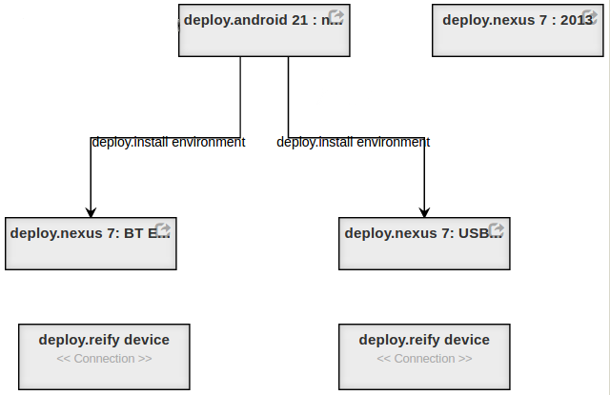
Modeling the Ecosystem
What is the ecosystem?
Why is the ecosystem important?
What have we done to model the ecosystem?
What next?
Execution Environment model
How are packages combined to form execution environments suitable for deployment to devices
The components are combined to form packages for specific purposes.
Notes:
Modelling the ecosystem
What have we done to model the ecosystem?
The Execution Environment Model assembles a set of component DFU’s into a deployable package.

Slide 24
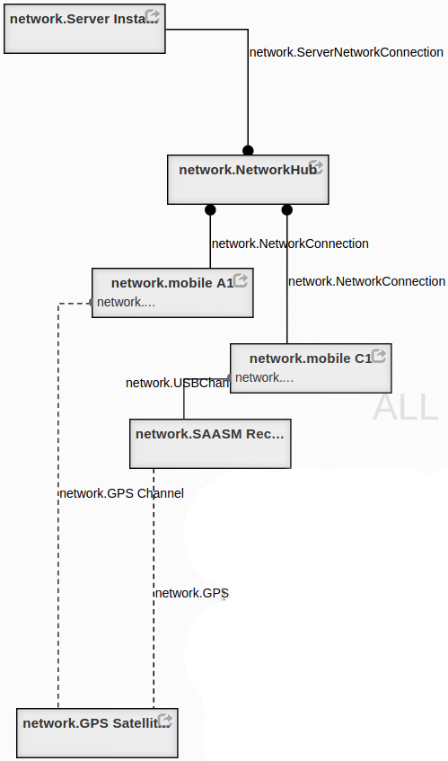
Modeling the Ecosystem
What is the ecosystem?
Why is the ecosystem important?
What have we done to model the ecosystem?
What next?
Network topology model
Along what paths are devices able to communicate?
The network topology model names hardware & their locations
Notes:
Modelling the ecosystem
What have we done to model the ecosystem?
The Network Topology Model describes the intended configuration of specific network devices.

Slide 25
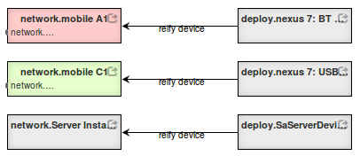
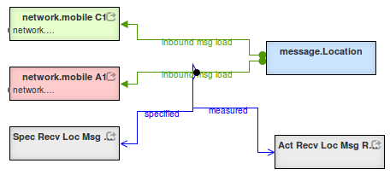
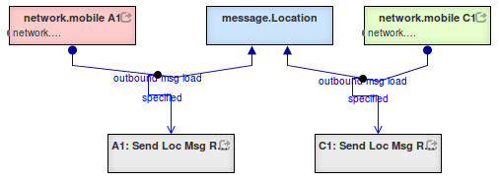
Modeling the Ecosystem
What is the ecosystem?
Why is the ecosystem important?
What have we done to model the ecosystem?
What next?
Mission model
Where do messages originate?
To whom are they directed?
Build a mega-model including cross-cuts
Notes:
Modelling the ecosystem
What have we done to model the ecosystem?
The Mission Model describes the goals for the application in a particular context.

Slide 26
Modeling the Ecosystem
What is the ecosystem?
Why is the ecosystem important?
What have we done to model the ecosystem?
What next?
Generate script to deploy software to specific devices
Formal methods
Type systems (DSL)
Construction following specification
Property-based testing & survey
Run time observation & measurement
Construct logger configuration to record & monitor key metrics
The ecosystem mega-model specifies behavior for the constructed system
Notes:
What next?
We generate a set of specifications from the ecosystem models.
These specifications can be used to verify the constructed system:
By formal methods (other players)
By type-systems (OSU)
By construction according to the model (in-progress )
By property-based testing in simulated environments (Syracuse)
By observation & measurement of fielded system (LL)
Property-based:
https://fsharpforfunandprofit.com/posts/property-based-testing-2/
https://www.youtube.com/watch?v=zi0rHwfiX1Q

Slide 28
Ontology
We model our problem space using a set of linked ontologies
ControlPoints are code regions where functionality equivalent components can be injected
Functional spec is conveyed by adding reusable properties to a core functional abstraction
Contrast with the strategy of explicitly enumerating all possible functionalities
E.g., a lossy compression algorithm for images:
compress : { lossy ^ applicableToDataType(Image) }
Core functionality abstraction
Simple property
Complex property
Property variable

Slide 29
Annotations
Annotations are one mechanism for conveying and storing knowledge about code
Programmer (provides high-level intent)
Static analysis (data flows, design patterns)
Dynamic analysis (resource use, live code behavior)
MUSE (extension of above)
We auto generate annotation-concept bindings that can later be parsed into semantic models
/**
* @param an array of bytes compressed with multi-pass LZMA (LZMA2)
* @return the decompressed data
*/
public @BinaryData byte[] decompress(
@BinaryData
@Compressed(compressionAlgorithm=LZMA2.class)
byte[] data
){

Slide 30
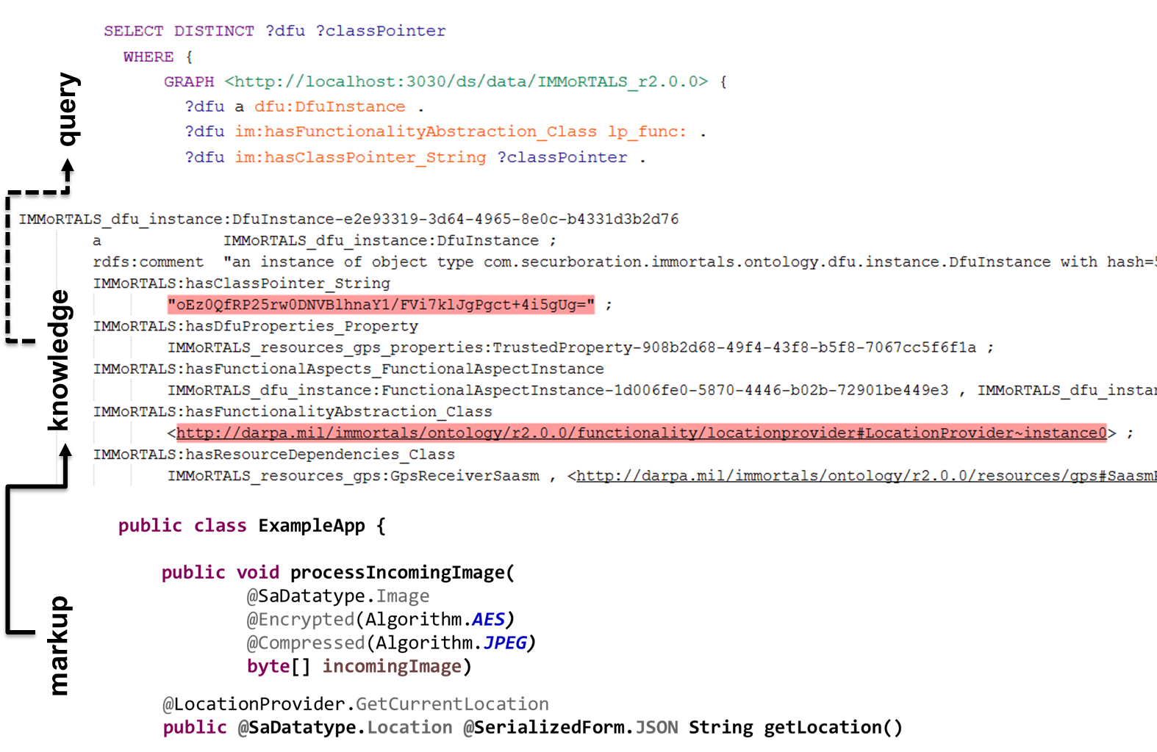
Use case

Slide 31
General Analysis Algorithm
Match Mission Functionality
Sent comments on this separately
Look for compose options (functionality)
X …
X …
X ...
No
Yes
Fit Resource Constraints
Look for compose options (resources)
No
Yes
Look for compose options (transforms)
Builds
No
Yes
Runs
Re-profile DFUs or Manual Input (e.g. fix DFU metadata)
No
Yes
Deploy new variant

Slide 32
Matching Mission Functionality
Map mission requirements to properties of functional units
For each type of functionality:
Evaluate if any available DFU implementation for a given type of functionality satisfies all required properties
Build list of compliant DFUs
If we have at least one candidate DFU for each type of functionality, move on to resource constraint checking.

Slide 33
Resource Constraint Checking:Placeholder for Eric
Eric will provide updated slides

Slide 34
Build and Test/Run
(TODO: some details about how program synthesis is going to work)
If build succeeds, run through validation tests
Deploy

Slide 35
Evolving code
Based on resource availability and mission requirements, for each control point, the DAS may dictate
Substitution: a drop-in replacement is available
Addition: composing 2 or more DFUs will be necessary
Removal

Slide 36
Composing DFUs
Functional: e.g. Explicit Mission requirement for data-at-rest encryption leads to implied requirement that the TrackLogger DFU must have “encrypted” property.
Need to compose a Crypto DFU with TrackLogger implementations to satisfy mission requirements.
Resource: compression of various forms trade off one resource for another
Transform: data-type transformations
e.g. (double lat, double lon) -> coordinate structure

Slide 37
Composing DFUs Challenges
Future plan?
Invertible?
Encryption and some kinds of compression need to be inverted (e.g. if you encrypt on the ‘write’ of some data, you need to decrypt on the ‘read’ of that same data).
Our application model will tell the DAS that two points in the application are linked, but challenges remain.
Ordering
The end result of encrypt(compress(byte[])) is very different from compress(encrypt(byte[])), which affects resource consumption.

Slide 38
Discovery via Mutation: Overview
Relying exclusively on annotations/DFU-based approach limits ability to discover non-critical resource uses in legacy or other non-annotated code
Solution: use the test suite to automatically identify non-critical functionality, map removal units to reclaimable resources
Mutate program P to program P’ that also passes test suite T
P’ has less code, but still passes all tests
Static and dynamic analysis used to split P-P’ into units and map those units to reclaimable resources
P
JavaReducer: Mutation + Delta Debugger
P’
T
T
Dynamic Analysis Traces: D
Dynamic Analysis Traces: D’
Static Analysis Result: S
Static Analysis Result: S’
Diff S-S’ D-D’
Resource Uses

Slide 39
Discovery via Mutation: Producing P’
Hierarchical delta debugging begins from bottom-up to remove code
Much larger removal units than traditional mutation testing
Looking for mutants that cannot be detected by test suite
Start removal at leaves of AST, move up
Resource uses: R1, R2, R3, R4, R5
Example:
Remove calls to system logger first
Remove initialization of system logger once all calls are gone
Result: P’ has less writes to SSD, lower memory usage (logging cache gone)
red code is removable
Resource uses: R1, R2, R4’, R5’ (R3 gone, R4/5 lower)

Slide 40
IMMoRTALS (Tactical SA) Platform
IMMoRTALS code base, build and test environment
Error report, deploy/update SW
IMMoRTALS Management Network
Host
Ecosystem
SA producer & consumer
Brokering and Storage
IMMoRTALS back end
Operational Network
Server Host
Android
Ecosystem
Ecosystem
Deployed/running platform application
Android Clients
Linux/Java Server
Backend
Change detection tools
Runtime management tools
Program synthesis tools
Build tools
Validation tools
Program analysis tools
Repo
y

Slide 41
Next Steps
Continue to evolve
Automate gathering of Application model
Work backward from DFUs in baseline application

Slide 42
IMMoRTALS (Tactical SA) Platform
IMMoRTALS code base, build and test environment
Error report, deploy/update SW
IMMoRTALS Management Network
Host
Ecosystem
SA producer & consumer
Brokering and Storage
IMMoRTALS back end
Operational Network
Server Host
Android
Ecosystem
Ecosystem
Deployed/running platform application
Android Clients
Linux/Java Server
Backend
Change detection tools
Runtime management tools
Program synthesis tools
Build tools
Validation tools
Program analysis tools
Repo
y

Slide 43
IMMoRTALS Test (TA-4) Interface
System Under Test (SUT)
DAS
(Diagnose, Transform, Build)
SA Client 1
Server
Platform network
SA Client n
2
Application binaries; configurations
5
Deploy Platform applications
1
Log Data
Test Scripts
3
Logging Service
Perturb SUT
(REST CALL)
4
6
7
Status (JSON)
Begin platform execution
Analyze Auxiliary data
Analyze Logs
Lincoln Test Harness

Slide 44
Conclusion

